Slide 1

Operating Systems 2-7029110
Dining Philosophers
Ariel University Computer Science Department
Notes:
http://pubs.opengroup.org/onlinepubs/009695399/functions/xsh_chap02_04.html
1

Slide 2
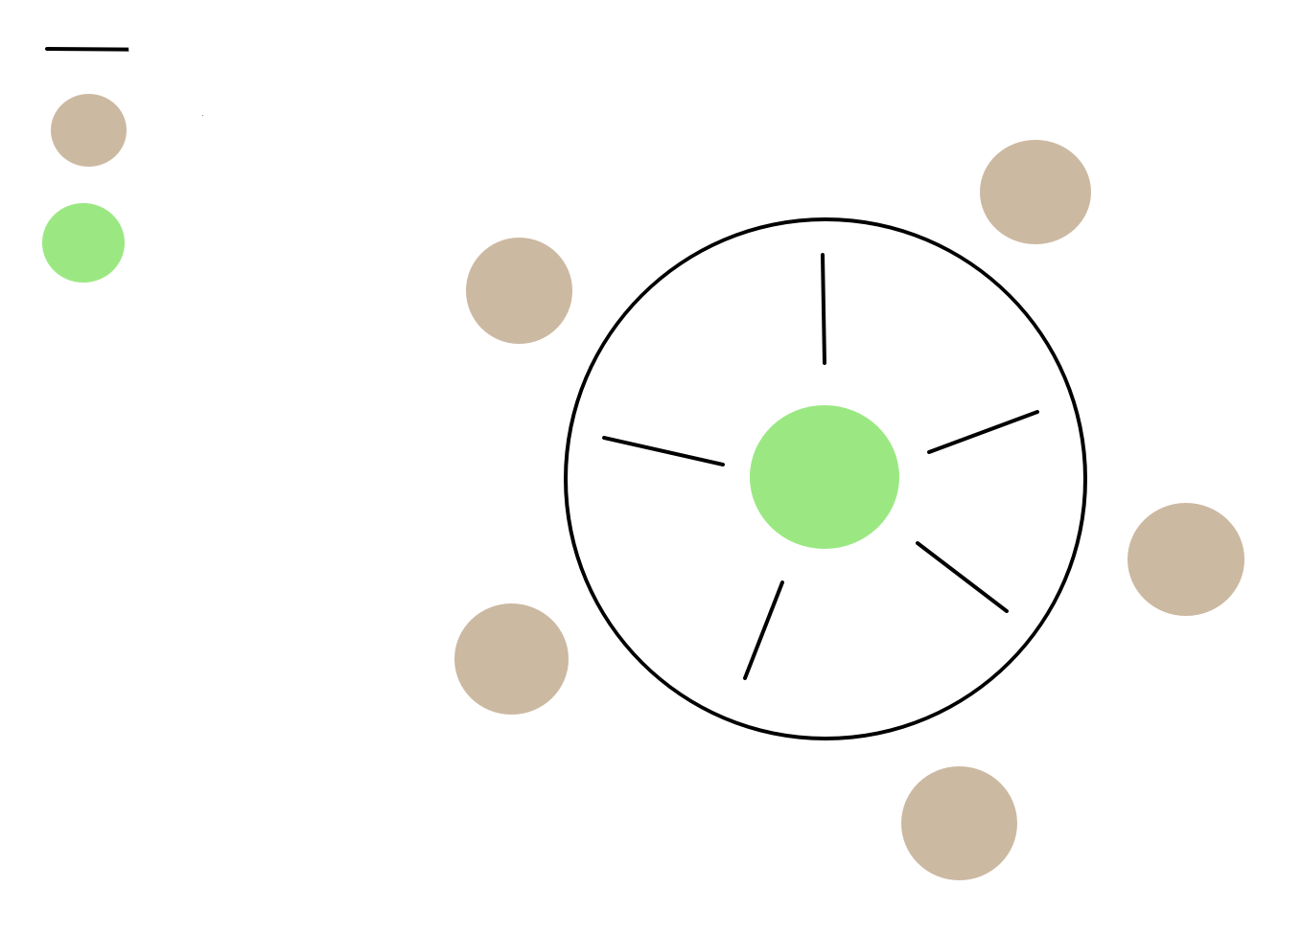
Native (Wrong) Solution
Chopstick
Philosopher
Salad
Waiting for a chopstick
Notes:
Open, close, duplicate
Handling signals
When are signals processed
Signals handlers
2

Slide 3

TextBook Solution
Chopstick
Philosopher
Salad
Solution: Central Mutex Lock
Take the Lock
2) Try to take the chopstick
Notes:
Open, close, duplicate
Handling signals
When are signals processed
Signals handlers
3

Slide 4
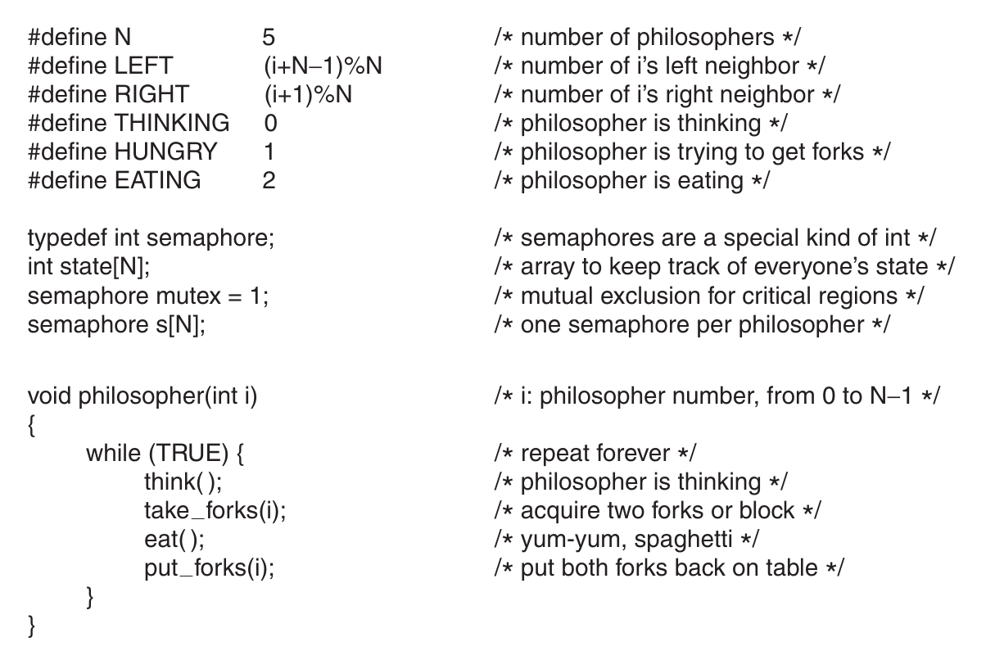
TextBook Solution
Moders OS: By A.Tanenbaum. Page 170
Notes:
Open, close, duplicate
Handling signals
When are signals processed
Signals handlers
4

Slide 5
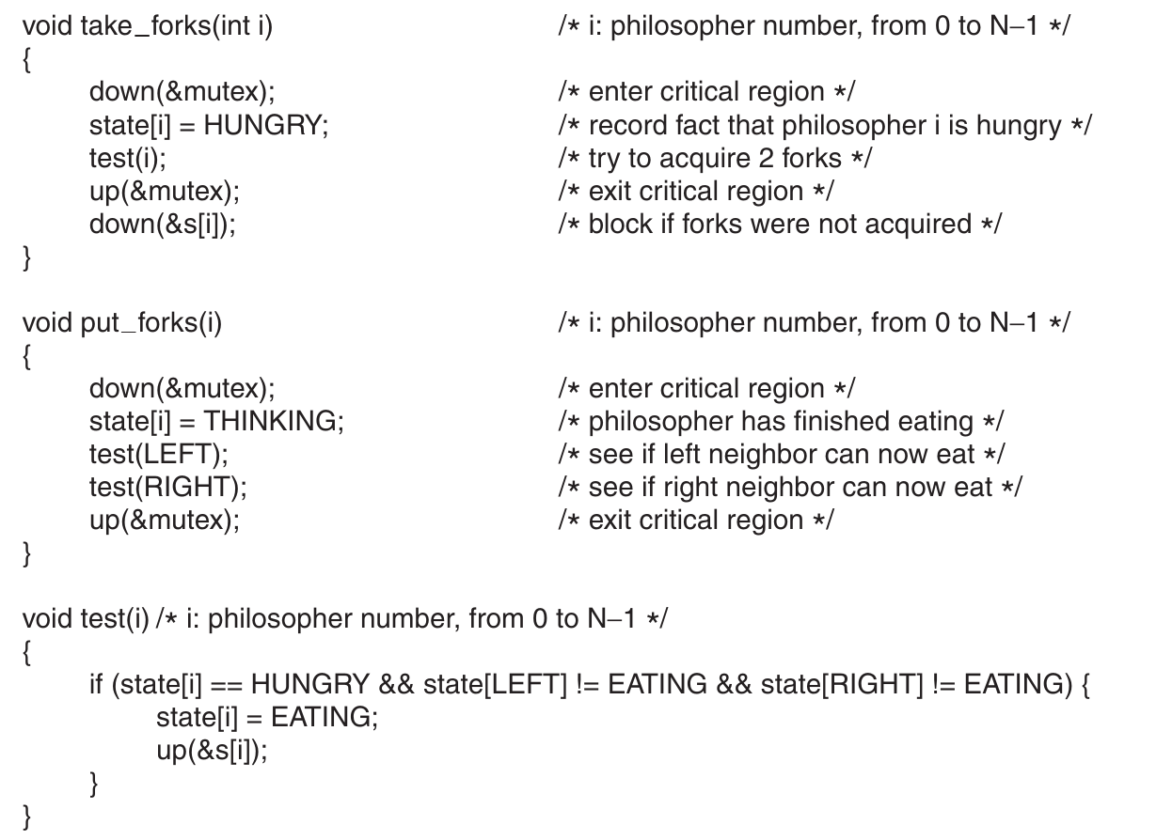
TextBook Solution
Moders OS: By A.Tanenbaum. Page 171
Notes:
Open, close, duplicate
Handling signals
When are signals processed
Signals handlers
5

Slide 6
LR-Solution
Chopstick
Philosopher
R
Salad
L
Two types of Philosophers: (L)eft-handed, and (R)ight handed: L will start from the left side, and wait till there is a chopstick available from the right. R will start from right, and wait for left side. The L and R assignition should be done one by one, let’s say even will be L and odd will be R.
L
R
R
Notes:
Open, close, duplicate
Handling signals
When are signals processed
Signals handlers
6

Slide 7
LR-Solution
Chopstick
Philosopher
R
Salad
L
Chopstick to start with
Two types of Philosophers: (L)eft-handed, and (R)ight handed: L will start from the left side, and wait till there is a chopstick available from the right. R will start from right, and wait for left side. The L and R assignition should be done one by one, let’s say even will be L and odd will be R.
L
R
R
Notes:
Open, close, duplicate
Handling signals
When are signals processed
Signals handlers
7

Slide 8
Native (Wrong) Solution
Assumption: Chopstick is fair
Chopstick
Philosopher
R
Salad
L
0
Chopstick to start with
An arbitrary fork to the left of an L-philosopher is numbered 0
Forks at (clockwise) distance i from it, for odd i, are numbered i+1
Forks at (clockwise) distance i from it , for even i, are numbered i-1 The result is a total order on fork numbers and each philosopher picks forks in ascending order. Hence the algorithm is deadlock-free.
3
2
L
R
1
4
R
Notes:
Open, close, duplicate
Handling signals
When are signals processed
Signals handlers
8

Slide 9
LR-Solution
Assumption: Chopstick is fair
Chopstick
Philosopher
R
Salad
L
0
Chopstick to start with
Why is the algorithm starvation-free? If a philosopher A waits for a resource held by philosopher B, then when B releases the resource it cannot again get it before A. Since the algorithm is deadlock-free, philosophers keep on taking and releasing resources, thus eventually B will release its resources and A will be able to obtain the resource.
Also note that, in fact, we don’t really need to assume that forks are fair, since only a single process can wait on any specific resource at a time.
3
2
L
R
1
4
R
Notes:
Open, close, duplicate
Handling signals
When are signals processed
Signals handlers
9

